Slide 1

HTML Basics
Tags and its uses

Slide 2
HTML Document
ALL HTML document starts with a declaration of <!DOCTYPE html>
It begins with <html> and ends with </html>
The visible part of the document is between <body> and </body>
Those in angular brackets are called tags

Slide 3
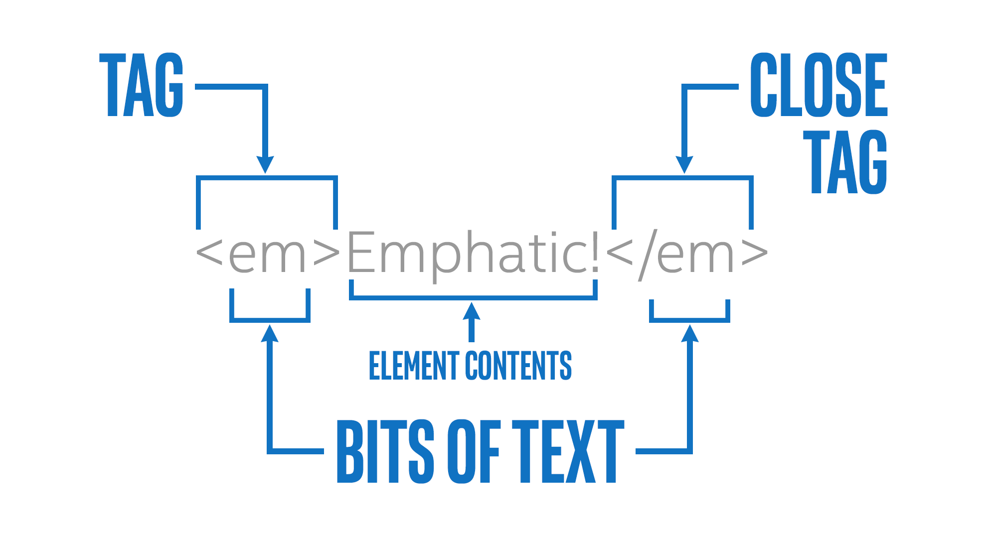

Slide 4
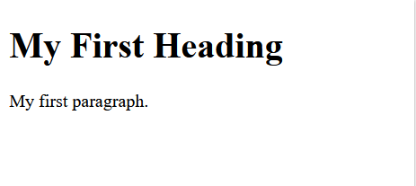
Example
<!DOCTYPE html> <html> <body> <h1>My First Heading</h1> <p>My first paragraph.</p> </body> </html>

Slide 5
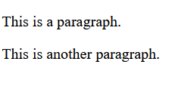
HTML Paragraphs
Defined with the <p> tags
<!DOCTYPE html>
<html>
<body>
<p>This is a paragraph</p>
<p>This is another paragraph</p>
</body>
</html>
Notes:
style attribute is used to add styles to an element, such as color, font, size, and more
title attribute defines some extra information about an element. The value of the title attribute will be displayed as a tooltip when you mouse over the element.

Slide 6
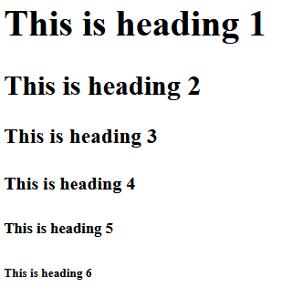
HTML Headings
Defined with <h1> to <h6> tags
<h1> has the greatest emphasise, or font size

Slide 7
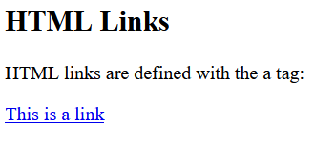
Html links
Defined using <a> tag
<!DOCTYPE html>
<html>
<body>
<h2>HTML Links</h2>
<p>HTML links are defined with the a tag:</p>
<a href="https://www.google.com">This is a link</a>
</body>
</html>
Notes:
href attribute specifies the URL of the page the link goes to

Slide 8
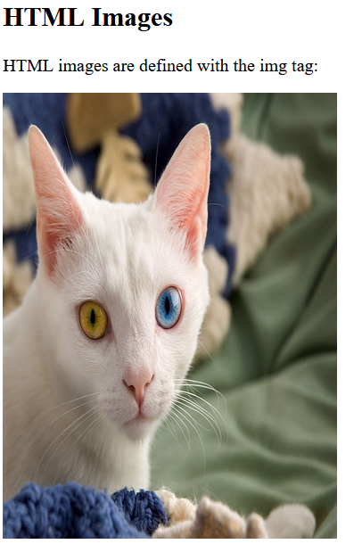
HTML IMAGES
Defined within <img> tag
<!DOCTYPE html>
<html>
<body>
<h2>HTML Images</h2>
<p>HTML images are defined with the img tag:</p>
<img src="https://upload.wikimedia.org/wikipedia/commons/thumb/a/a3/June_odd-eyed-cat.jpg/1106px-June_odd-eyed-cat.jpg" alt=“cat image" width=“300" height=“400">
</body>
</html>
Notes:
src attribute specifies the path to the image to be displayed
Absolute path vs relative. Always, as good practice, to use relative paths.
width and height attributes specifies the width and height of the image (in pixels)
alt attribute for the <img> tag specifies an alternate text for an image, if the image for some reason cannot be displayed, or for screen reader (people visually handicapped uses this feature to navigate around)

Slide 9
HTML Attributes
Attributes provide additional information about the element.
Always specified in the start tag.
Comes in a name-value pair e.g. attribute=“value”

Slide 10
Always!
Remember to close of the end tag.
Do not do it as follows:
<html> <body> <p>This is a paragraph <p>This is a paragraph </body> </html>
Notes:
Such case may produce unexpected behaviour in different browsers

Slide 11
Task 2
Create a webpage that has a header that says “any random favourite stuff”.
Insert your any random favourite stuff’s image into the webpage.

